Slide 1
DSA5204 Project: Can Time Series Imaging Improve Modeling of Temporal Dependencies?
Jonathan Yeo (A0164616A)
Maximilian (A0251292J)
Tan Zheng Xun (A0192520M)
Jonathan Lim Zhi Wei (A0156098U)
Lee Jian Ming (A0180015W)

Slide 2
Table of Contents
Objective
Data Preprocessing
LSTNet
Gramian Angular Field Imaging
One-Step Forecast
Recursive Forecast
Hyperparameter Tuning
DSA5204 Project: Can Time Series Imaging Improve Modeling of Temporal Dependencies?
Notes:
2

Slide 3
Objective
Transforming time series data into images
Utilising CNNs for feature recognition in time series forecasting
Gramian Angular Summation/Difference Fields (GASF, GADF)
Forecasting future results
DSA5204 Project: Can Time Series Imaging Improve Modeling of Temporal Dependencies?
Notes:
3

Slide 4
Data Preprocessing

Slide 5
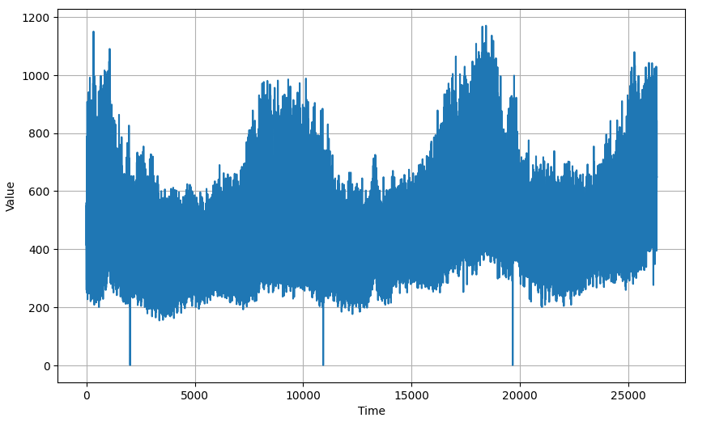
Exploratory Data Analysis
Hourly Data → Electricity Load Diagrams from UCI machine learning repository
Using one of the series within the data (univariate series)
DSA5204 Project: Can Time Series Imaging Improve Modeling of Temporal Dependencies?
Notes:
This is a multivariate time series dataset, containing electricity consumption data in kWh, recorded every 15 minutes from 2011 to 2014. The final dataset contains the electricity consumption data of 321 clients from 2012 to 2014, and converted to reflect hourly consumption.
5

Slide 6
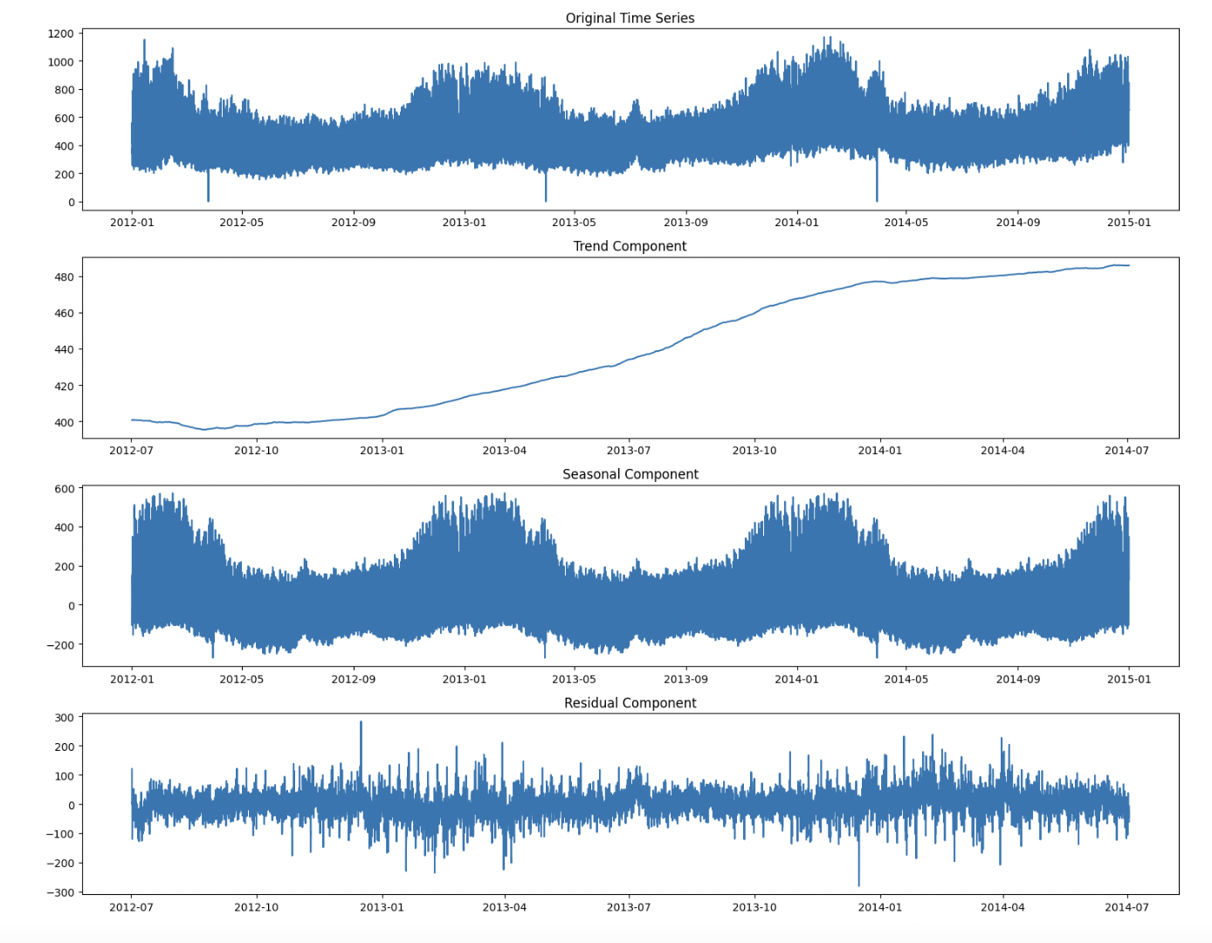
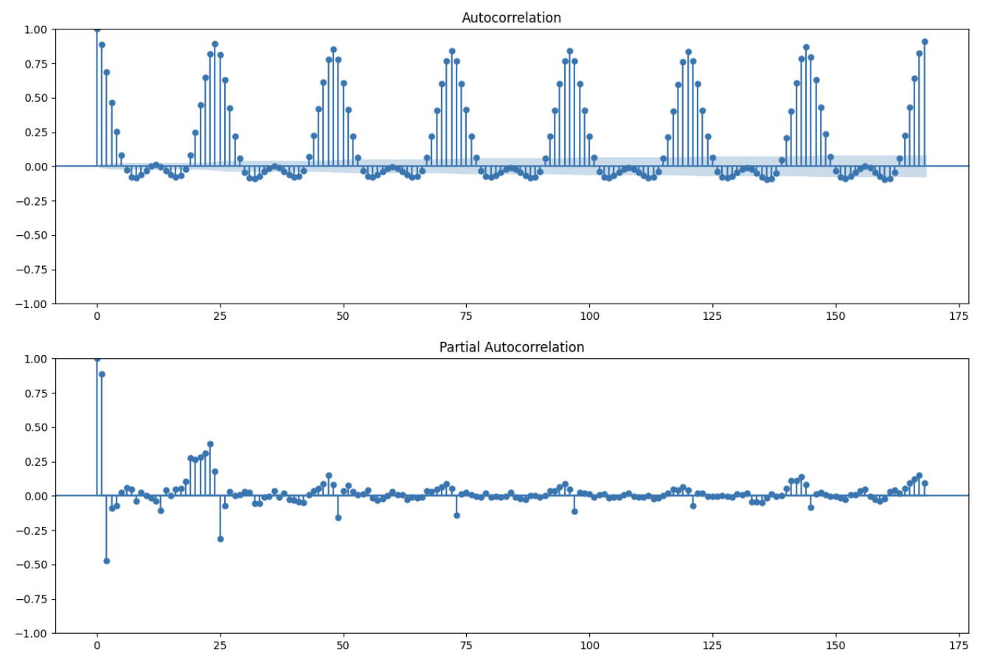
Performing basic time series decomposition
Data exhibits strong seasonality
DSA5204 Project: Can Time Series Imaging Improve Modeling of Temporal Dependencies?

Slide 7
Training-Test Split
Split into 80% for training and 20% for testing
For tuning, 25% of train set is used as validation
Labels for GAF input are normalised between ±1
Key parameters used for the code:
Parameter | Value
Window Size | 1 week
Batch Size | 32
Shuffle Buffer Size | 1000
Stride | 1hr (LSTNet) 24hr (GAF-LSTNet)
DSA5204 Project: Can Time Series Imaging Improve Modeling of Temporal Dependencies?
Notes:
7

Slide 8
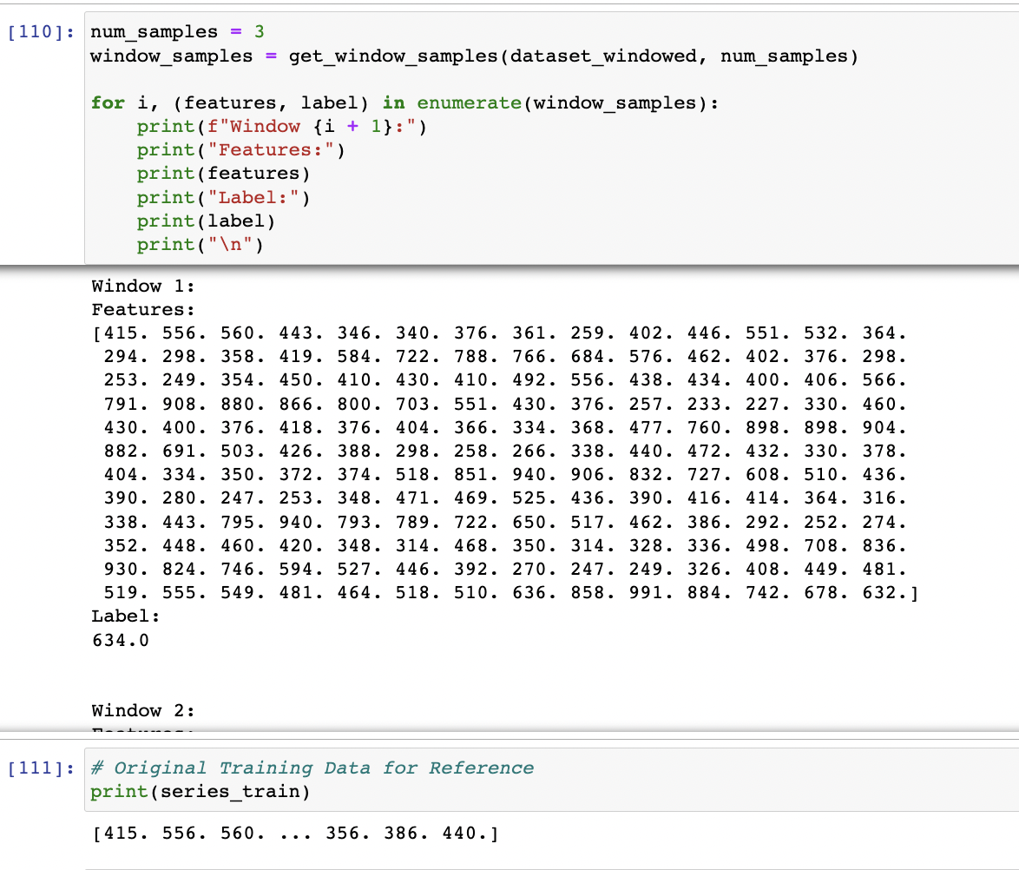
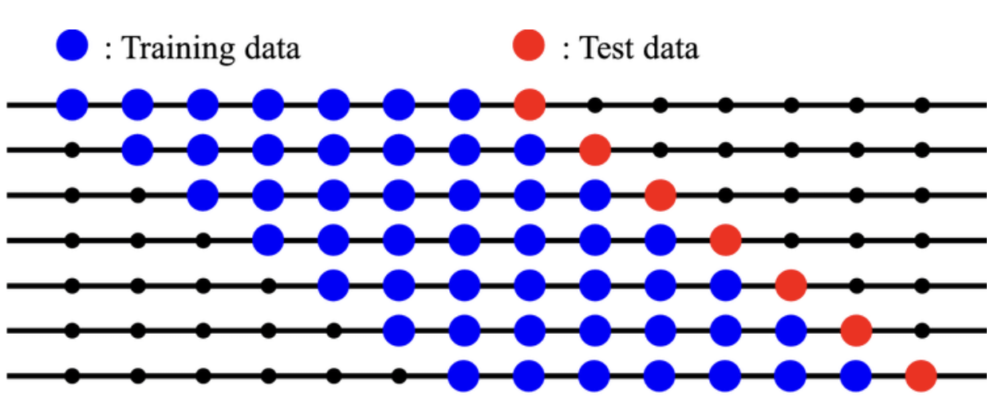
Sliding Window
Feature-Label Preparation
DSA5204 Project: Can Time Series Imaging Improve Modeling of Temporal Dependencies?

Slide 9
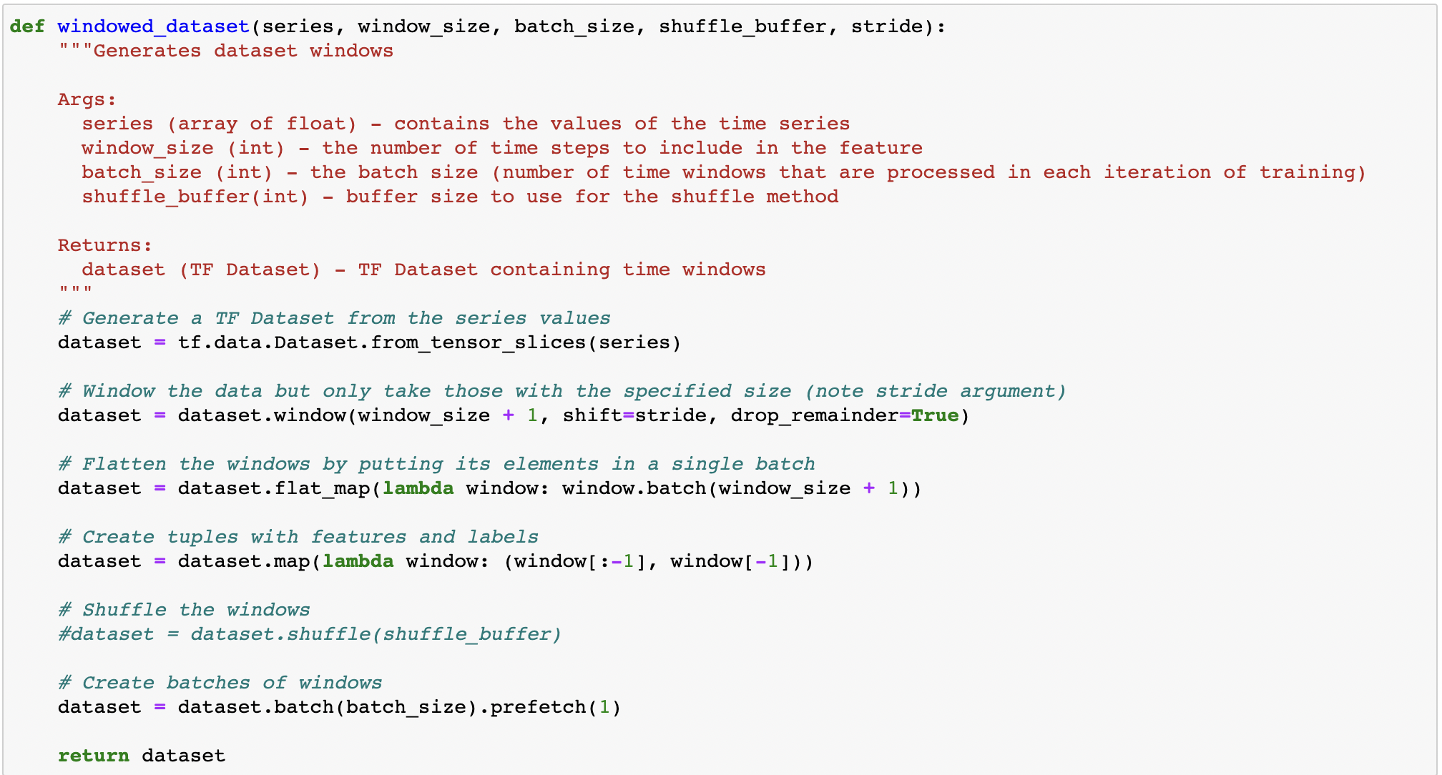
Sliding Window
DSA5204 Project: Can Time Series Imaging Improve Modeling of Temporal Dependencies?

Slide 10
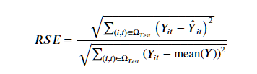
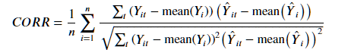
Time Series Forecasting Metrics
Mean Absolute Error (MAE) and Mean Squared Error (MSE)
Additional evaluation metrics:
Root relative squared error (the lower the better)
Empirical correlation coefficient (the higher the better)
DSA5204 Project: Can Time Series Imaging Improve Modeling of Temporal Dependencies?
Notes:
10

Slide 11
LSTNet
Notes:
Now I will introduce the LSTNet model, which is specifically designed for multivariate time series forecasting.
The goal of LSTNet is to overcome the limitations of traditional methods in time series forecasting, such as ARIMA models, by capturing both long- and short-term patterns in time series data using a combination of Convolutional and Recurrent Neural Networks.

Slide 12
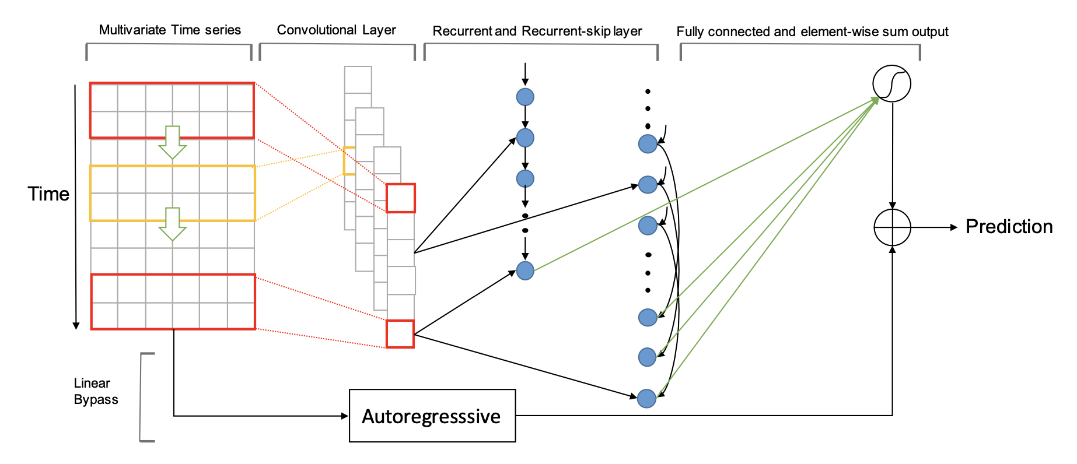
LSTNet Model Architecture
DSA5204 Project: Can Time Series Imaging Improve Modeling of Temporal Dependencies?
Notes:
The LSTNet model architecture consists of 5 main components:
The first layer is a 1D convolutional component without pooling. This layer is used to extract short-term patterns in the time dimension and local dependencies between variables.
The second component is the Recurrent Component, which includes two parts. The model uses a Gated Recurrent Unit (GRU), a variant of the LSTM, to help the model learn longer-term dependencies.
However, recurrent networks often fall short due to the vanishing gradient problem. To address this issue, the model introduces a recurrent-skip connection. To implement this component, a skip hyperparameter must be specified. The idea behind the skip is to learn different time points to account for the seasonality period in the time series data, enabling the model to better capture long-term dependencies.
Finally, a classic autoregressive component is concatenated with the output of the recurrent component to yield the final forecast prediction.

Slide 13
LSTN Model Architecture
Main model architecture
Convolutional Component – 3 kernels, ‘ReLU’ activation
Recurrent Component – 100 GRUs, ‘ReLU’ activation
Recurrent Skip Component – 50 GRUs, ‘ReLU’ activation
Temporal Attention Layer – 2 heads, 100 dimension for each key
Autoregressive Component – current value of a variable is modeled as a linear combination of its past values
L2 regularisation
DSA5204 Project: Can Time Series Imaging Improve Modeling of Temporal Dependencies?
Notes:
To address the issue of needing to know the period of seasonality in advance to choose a good skip hyperparameter, an attention mechanism can be utilized to create a temporal attention layer specifically designed for nonseasonal time series predictions. This layer allows the model to automatically learn and focus on relevant time points without the need for specifying seasonality information.

Slide 14
LSTN – Skip-GRU
Variant of a Gated Recurrent Unit (GRU) – Skip path and GRU path
Skip path – bypass the GRU layer and directly added to output
GRU path – processes input sequence and captures the temporal dependencies
Skip-GRU
Captures short-term and long-term dependencies in time series data
Allows model to selectively skip over certain time steps
Useful for long time sequences
DSA5204 Project: Can Time Series Imaging Improve Modeling of Temporal Dependencies?
Notes:
This slide goes into greater detail on the specifics of how the recurrent-skip is implemented, in the form of a Skip-GRU cell, which is just a variant of the traditional GRU that incorporates skip connections into its architecture.

Slide 15
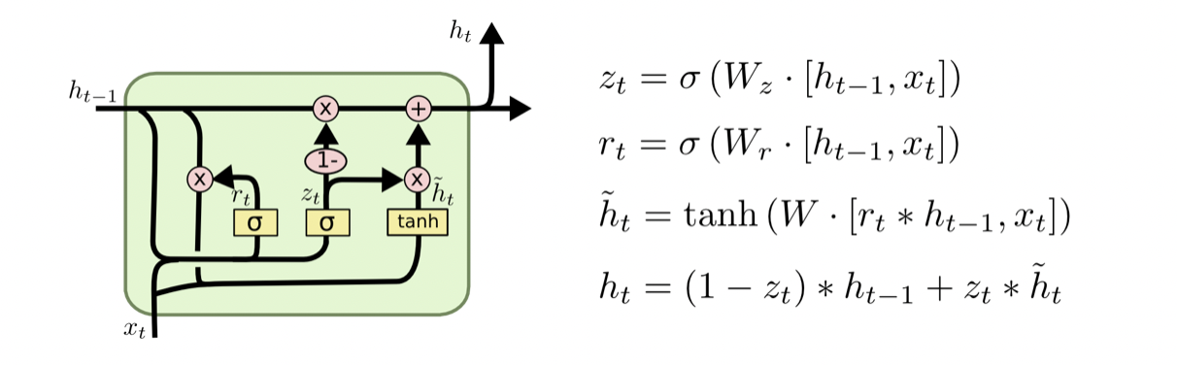
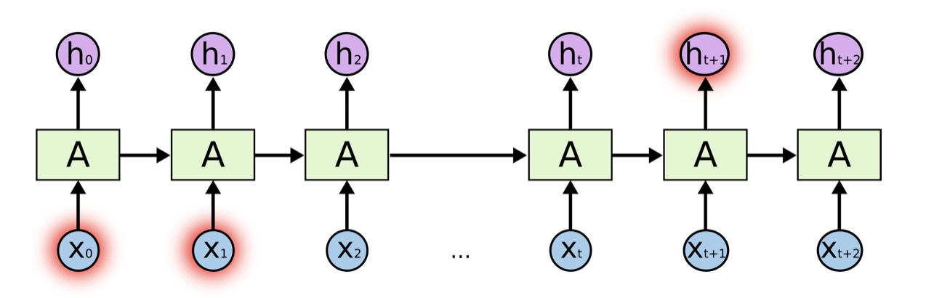
DSA5204 Project: Can Time Series Imaging Improve Modeling of Temporal Dependencies?
Notes:
Here we have the architecture for a classic GRU cell. The usual input, update and forget gate still apply, where the main difference of the Skip-GRU coming in where we use the skip connection to go from one hidden state to another, and basically bypass the update and forget gate.

Slide 16
Gramian Angular Field Imaging
Notes:
Next, we would like to introduce the concept of Gramian Angular Fields.

Slide 17
Motivation
Wang and Oates (2015) proposed two novel methods for encoding time series data as images while preserving temporal dependencies: Gramian Angular Summation/Difference Fields (GASF, GADF) and Markov Transition Fields (MTF).
Leveraging the power of Convolutional Neural Networks (CNNs) for feature recognition in time series classification tasks.
Attempts in the literature that seek to extend this to time series forecasting
E.g. Day-Ahead Solar Irradiation Forecasting, Hong et al. (2020)
DSA5204 Project: Can Time Series Imaging Improve Modeling of Temporal Dependencies?
Notes:
Gramian Angular Field (or GAF) transforms were first introduced as a means for encoding univariate time series data into an image representation, such that temporal dependencies between the time series data points are preserved.
Through this encoding process, the idea is to take advantage of the power of Convolutional Neural Networks for feature recognition in time series classification tasks, which has been demonstrated in the literature to be effective - these examples will be cited in our final report.
But this is for classification, and we want to try to extend this approach to perform the task of forecasting instead, as was attempted in this paper by Hong et al.
17

Slide 18
Gramian Angular Field
Image representation that encode temporal dependencies in time series data
Projects time series points into a polar coordinate system
Value is encoded in the angular cosine while the radius corresponds to the time index
Involves three encoding steps
Rescaling (Mean Normalization)
Converting to polar coordinates
Calculating Gramian Angular Matrices
DSA5204 Project: Can Time Series Imaging Improve Modeling of Temporal Dependencies?
Notes:
Intuitively, how the encoding process works is that it projects your time series data points into a polar coordinate representation, where the radius corresponds to the time index, and the value is encoded in the angular cosine.
There are three main encoding steps in this process:
1. First, we normalize the time series to lie within the range of [-1,1]
2. Next, we perform the polar coordinate transformation
3. And lastly, we compute our Gramian Angular Field matrices, which you can think of as 2-dimensional texture images. I will go into how this matrix looks like shortly.
18

Slide 19
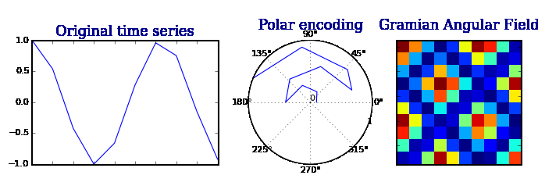
Gramian Angular Field
DSA5204 Project: Can Time Series Imaging Improve Modeling of Temporal Dependencies?
Notes:
The next slide gives a more concrete visual intuition of how the encoding basically works. You have the time series data, the polar coordinate representation, and lastly the image representation.
19

Slide 20
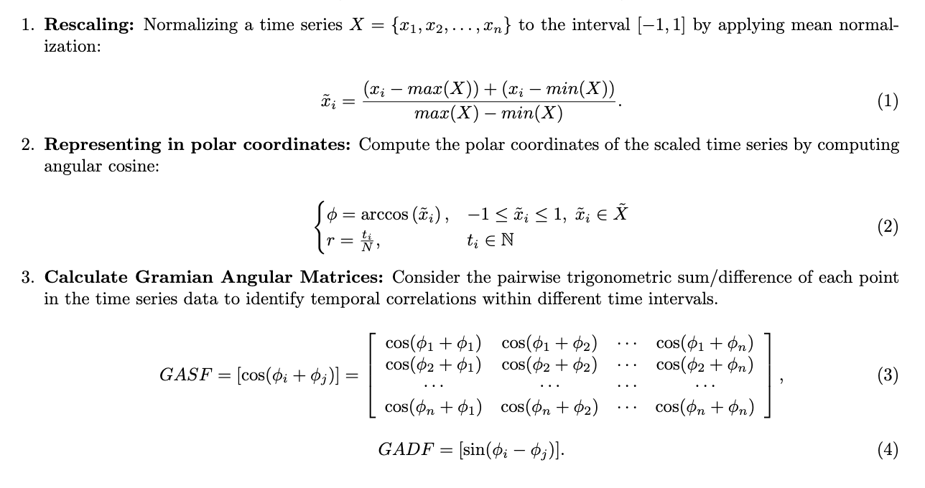
Gramian Angular Field
DSA5204 Project: Can Time Series Imaging Improve Modeling of Temporal Dependencies?
Notes:
And lastly, we have the detailed mathematical formulation of the transform. I would like to direct your attention to the last point on the GAF matrices, and you can see that it’s basically taking the pairwise trigo sum, or difference between each polar coordinate value of the time series.
20

Slide 21
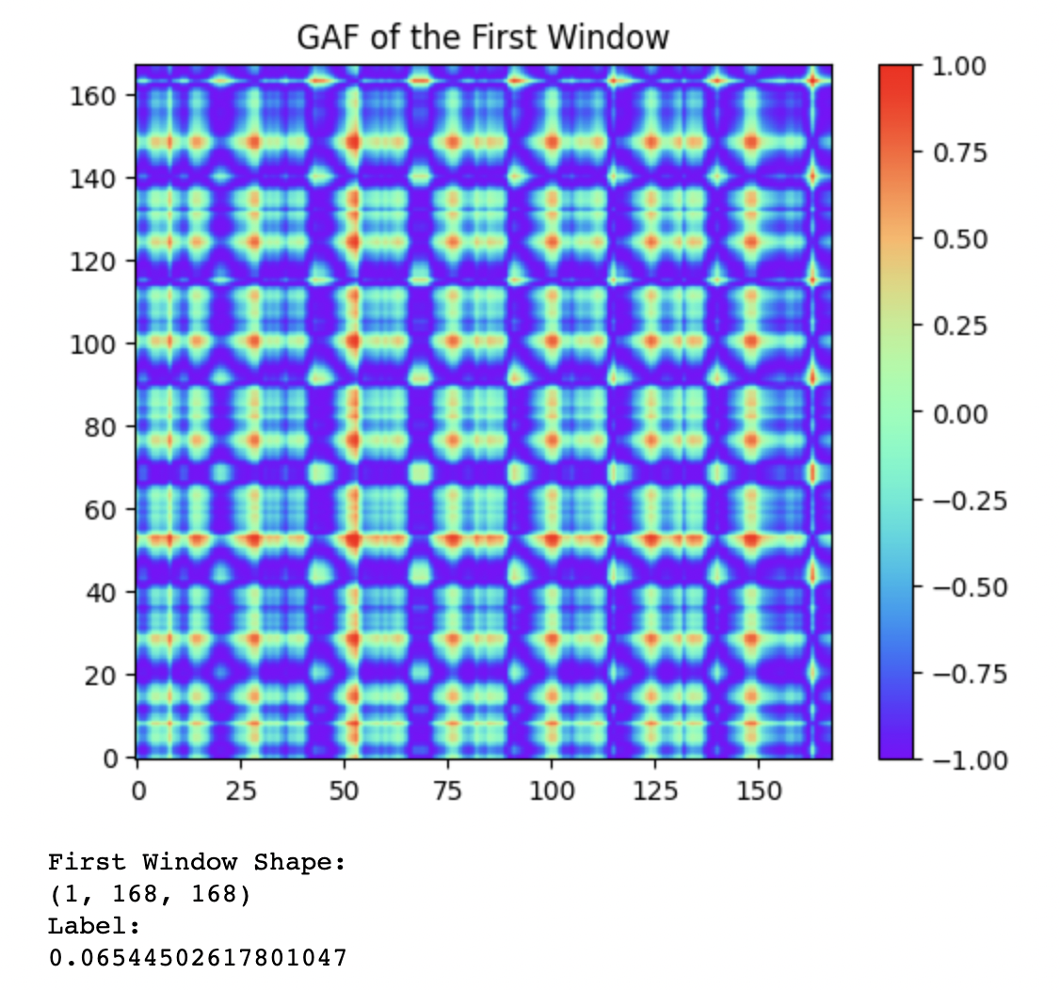
Modified Data Processing Pipeline
DSA5204 Project: Can Time Series Imaging Improve Modeling of Temporal Dependencies?
Notes:
Previously, we described the data processing pipeline for our time series data as a sliding window of your training data and target label. To perform model training with LSTNet using GAF images as the input data, we need a modified data pipeline, but the idea is still quite simple.
We take each window of training data, perform the GAF transform on that window, and additionally, we apply the normalization to the target label as well. And with that, we are ready to start testing the performance of GAF inputs for forecasting.
\\ END
21

Slide 22
One-Step forecast

Slide 23
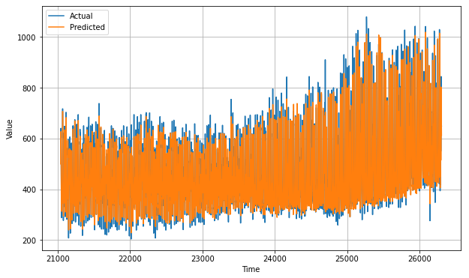
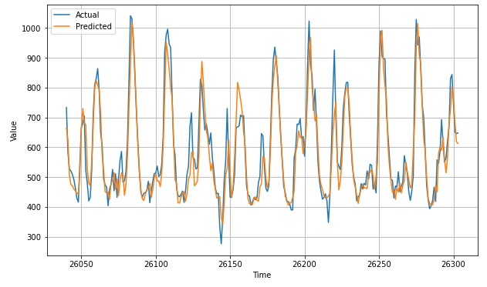
One-step forecast (Time-series input)
Results of a one-step forecast
Entire time series (left) and last few timesteps (right)
Predicts amplitude and does not have significant phase lag
DSA5204 Project: Can Time Series Imaging Improve Modeling of Temporal Dependencies?

Slide 24
One-step forecast
Compared against naive forecast
 | Naive Forecast | One-step Forecast
MSE | 4952 | 2099
MAE | 51.25 | 33.45
DSA5204 Project: Can Time Series Imaging Improve Modeling of Temporal Dependencies?

Slide 25
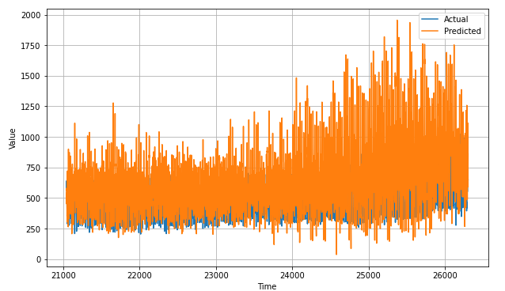
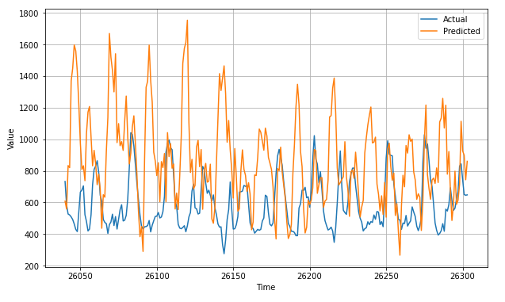
One-step forecast (GAF input)
Entire time series (left) and last few timesteps (right)
Amplitude prediction is very far off from actual results
Phase lag as well (peaks and troughs are opposite)
DSA5204 Project: Can Time Series Imaging Improve Modeling of Temporal Dependencies?

Slide 26
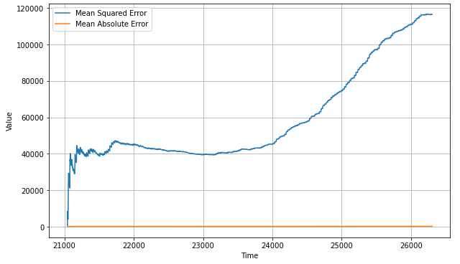
One-step forecast (GAF input)
Mean squared error is growing as time increases
Might be overfitting the training data
DSA5204 Project: Can Time Series Imaging Improve Modeling of Temporal Dependencies?

Slide 27
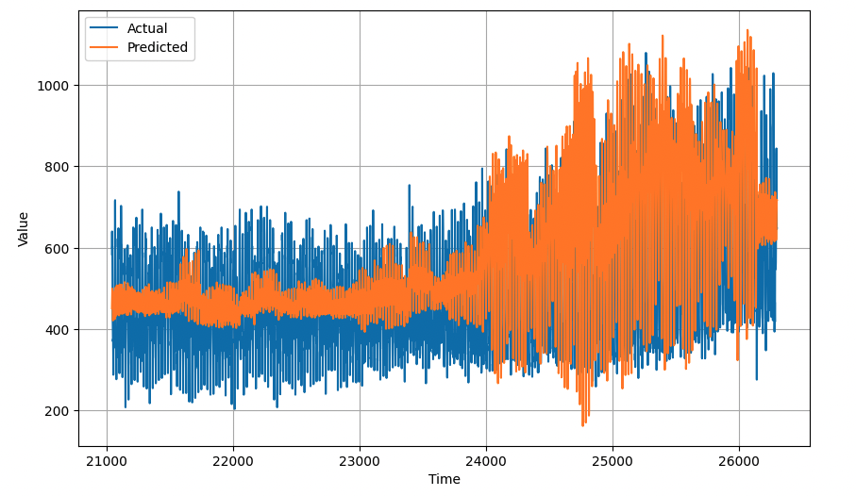
Alternative Attempt for GAF (2DConvLSTM)
Attempt to replicate the work of Hong et al. in using 2DConvLSTM on GAF time series inputs
DSA5204 Project: Can Time Series Imaging Improve Modeling of Temporal Dependencies?

Slide 28
Recursive Forecast
Extension of LSTNet 1-step ahead model

Slide 29
Recursive forecast
Uses the one-step ahead model to predict multiple steps ahead
Uses previous forecasts to predict the next (by recursion)
Input Window
Forecast 1:
Forecast 2: |  |  |  |  | Pred 1
Forecast 3: |  |  |  |  | Pred 1 | Pred 2
Forecast 4: |  |  |  |  | Pred 1 | Pred 2 | Pred 3
Pred 1
Pred 2
Pred 3
Pred 4
t = 1 | t = 2 | t = 3 | t = 4 | t = 5 | t = 6 | t = 7 | t = 8 | t = 9
Train Data
Unseen Data
DSA5204 Project: Can Time Series Imaging Improve Modeling of Temporal Dependencies?

Slide 30
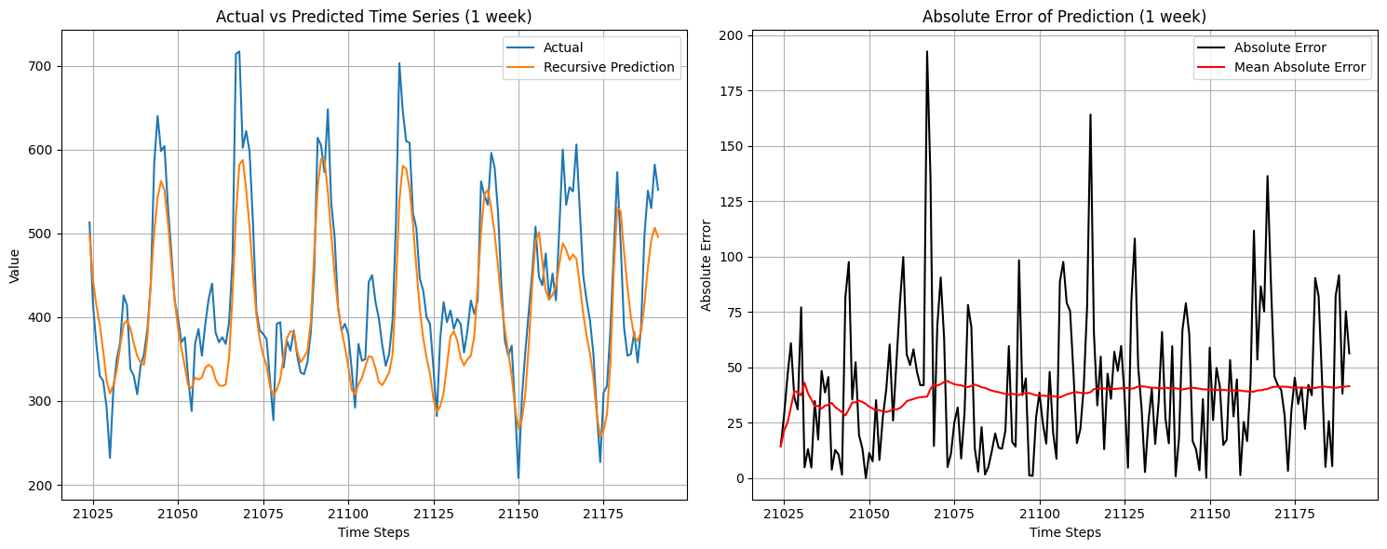
Recursive Forecast on LSTNet (1 week)
Good prediction of amplitude and phase for 1st week
Mean absolute error (MAE) stable at within 10%
DSA5204 Project: Can Time Series Imaging Improve Modeling of Temporal Dependencies?

Slide 31
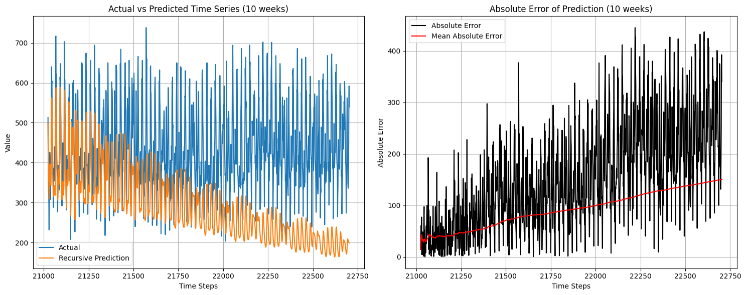
Recursive Forecast on LSTNet (10 weeks)
Amplitude decays and bias increases with time as errors pile up
Error produces bad features which create more error (MAE > 40%)
DSA5204 Project: Can Time Series Imaging Improve Modeling of Temporal Dependencies?

Slide 32
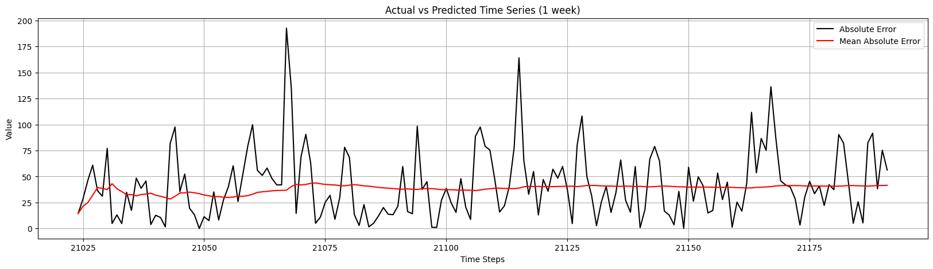
Rectifying the Recursive Forecast
Recursive forecast tend to vanish due to accumulating errors
These errors have a temporal structure
One way to rectify is to model and predict the error
DSA5204 Project: Can Time Series Imaging Improve Modeling of Temporal Dependencies?

Slide 33
Rectifying the Recursive Forecast
Training
Forecasting
Input Window 1
Pred 1
Input Window
from time t-2 to t
One-Step Ahead Forecast
Input Window 2
Pred 2
Baseline
LSTNet Model
Error
LSTNet Model
Input Window 3
Pred 3
t = 1 | t = 2 | t = 3 | t = 4 | t = 5 | t = 6
Error Series:
Error 1 | Error 2 | Error 2
Baseline Prediction for t+1
Error Prediction for t+1
Input Window 1
Error 1
Model to Predict Error
+
Input Window 2
Error 2
Rectified Prediction for t+1
Input Window 3
Error 3
DSA5204 Project: Can Time Series Imaging Improve Modeling of Temporal Dependencies?

Slide 34
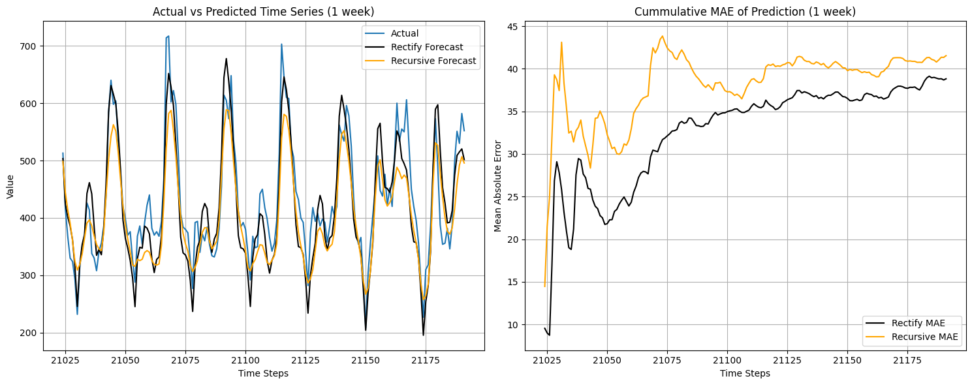
Rectify Forecast on LSTNet (1 week)
Better prediction of amplitude for 1st week (lower MAE)
For recursive, errors tend to occur at peaks and troughs
This is rectified by modelling the errors
DSA5204 Project: Can Time Series Imaging Improve Modeling of Temporal Dependencies?

Slide 35
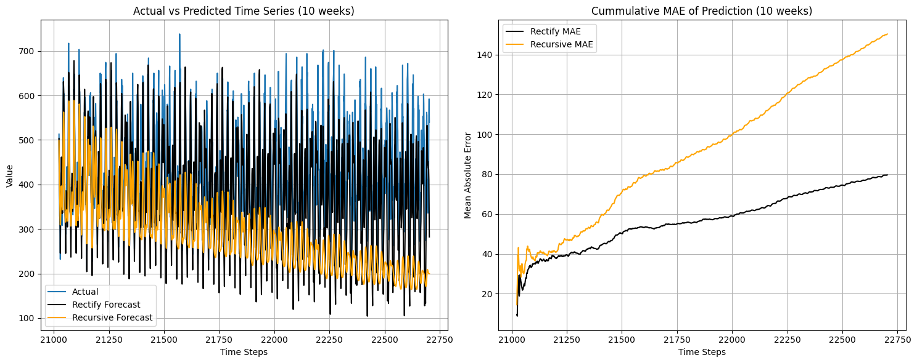
Rectify Forecast on LSTNet (10 weeks)
Better prediction over a longer time horizon
Vanishing amplitude and increasing bias issues were resolved
DSA5204 Project: Can Time Series Imaging Improve Modeling of Temporal Dependencies?

Slide 36
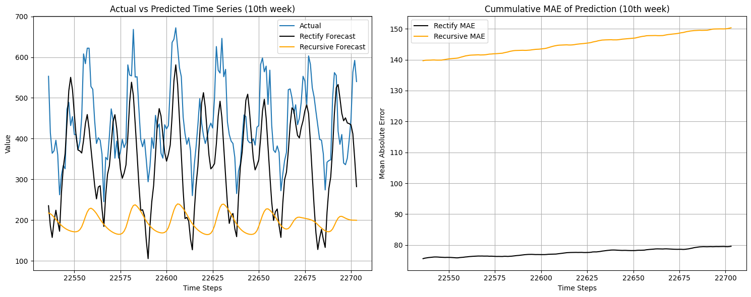
Rectify Forecast on LSTNet (10th week)
Good prediction of amplitude and phase even on the 10th week
MAE reduced by half
DSA5204 Project: Can Time Series Imaging Improve Modeling of Temporal Dependencies?

Slide 37
Hyperparameter Tuning

Slide 38
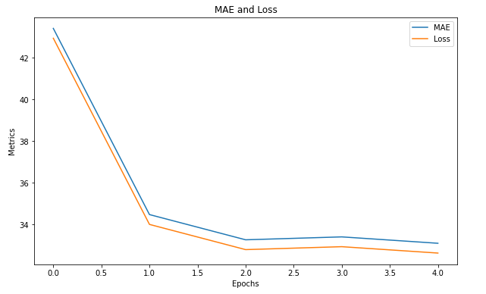
LSTN Training (Time data input)
Total trainable parameters = 164 809
Mean absolute error and loss plotted below
DSA5204 Project: Can Time Series Imaging Improve Modeling of Temporal Dependencies?

Slide 39
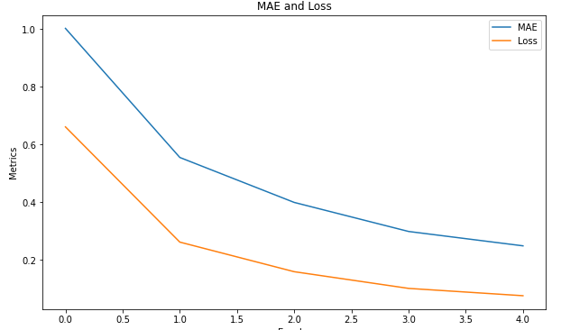
LSTN Training (GAF input)
Total trainable parameters = 31.6 million
Mean absolute error and loss plotted below
DSA5204 Project: Can Time Series Imaging Improve Modeling of Temporal Dependencies?

Slide 40
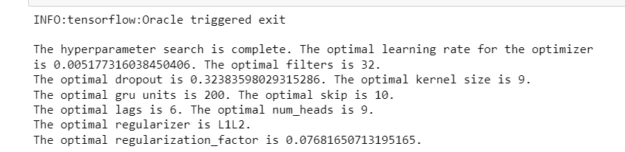
LSTN Hyperparameter Tuning
Hyperparameter Tuning was conducted for the LSTN model (without skip-GRU layer) using Keras Tuner (Hyperband) through 150 trials.
The trial with the best validation MAE was used for forecasting
Improved LSTN model for time series data significantly but GAF data still experiences poor prediction
DSA5204 Project: Can Time Series Imaging Improve Modeling of Temporal Dependencies?

Slide 41
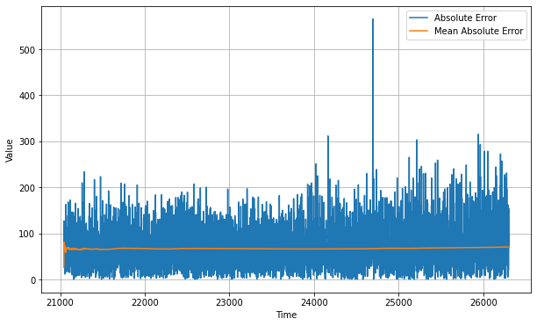
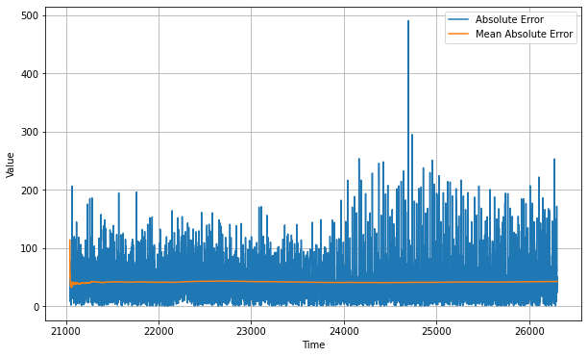
LSTN Hyperparameter Tuning Results
Test MAE score improved from 62.3 to 42.2 through Hyperparameter tuning.
Baseline Model
Hyperparameter Tuned Model
DSA5204 Project: Can Time Series Imaging Improve Modeling of Temporal Dependencies?

Slide 42
LSTN Overview (Baseline)
Input Layer (168)
Input Layer
1D Conv 64 filters with kernel size of 3
GRU of 100 units
Multihead attention of 2 units
Skip-GRU of 50 units
Autoregressive component
Output Layer
No Dropout
L2 regularizer of 0.01 was used
1D Convolution Layer
Gated Recurrent Unit
Multihead Attention
Skip-Gated Recurrent Unit
Autoregressive
Output
DSA5204 Project: Can Time Series Imaging Improve Modeling of Temporal Dependencies?

Slide 43
LSTN Overview (Tuned)
Input Layer (168)
Input Layer
1D Conv 32 filters with kernel size of 9
GRU of 200 units
Multihead attention of 4 units
Autoregressive component
Output Layer
Dropout of factor 0.324 was included
L1L2 regularizer of 0.077 was used
1D Convolution Layer
Gated Recurrent Unit
Multihead Attention
Autoregressive
Output
DSA5204 Project: Can Time Series Imaging Improve Modeling of Temporal Dependencies?

Slide 44
LSTN Summary
Too many trainable parameters, much more trials needed
Possible to further improve the model but training time for hyperparameter tuning is computationally expensive
Number of epochs was limited to 10 to reduce computational time
SGD was used instead of ADAM to increase training speed
Keras Tuner not compatible with skip-GRU addition
DSA5204 Project: Can Time Series Imaging Improve Modeling of Temporal Dependencies?

Slide 45
LSTN Results
RSE and CORR was computed for Time Series and GAF input
GAF seems to produce better results for both RSE and CORR
Cannot compare MAE and losses due to normalisation of GAF input data
 | Time Series | GAF
RSE | 1.45 | 1.75
CORR | 0.210 | 0.229
DSA5204 Project: Can Time Series Imaging Improve Modeling of Temporal Dependencies?

Slide 46
References
[1] Lai, G., Chang, W., Yang, Y. & Liu, H. Modeling Long- and Short-Term Temporal Patterns with Deep Neural Networks. (arXiv,2017), https://arxiv.org/abs/1703.07015
[2] Wang, Z. & Oates, T. Imaging Time-Series to Improve Classification and Imputation. CoRR. abs/1506.00327 (2015), http://arxiv.org/abs/1506.00327
[3] Vaswani, A., Shazeer, N., Parmar, N., Uszkoreit, J., Jones, L., Gomez, A., Kaiser, L. & Polosukhin, I. Attention is All you Need. Advances In Neural Information Processing Systems. 30 (2017), https://proceedings.neurips.cc/paper/2017/file/3f5ee243547dee91fbd053c1c4a845aa-Paper.pdf
[4] Campos, V., Jou, B., Gir´o-Nieto, X., Torres, J. & Chang, S. Skip RNN: Learning to Skip State Updates in Recurrent Neural Networks. International Conference On Learning Representations. (2018), https://openreview.net/forum?id=HkwVAXyCW
[5] Taieb, Souhaib Ben; Hyndman, Rob J (2012): Recursive and direct multi-step forecasting: the best of both worlds. Monash University. Journal contribution.
[6] Hong, Y., Martinez, J. & Fajardo, A. Day-Ahead Solar Irradiation Forecasting Utilizing Gramian Angular
Field and Convolutional Long Short-Term Memory. IEEE Access. 8 pp. 18741-18753 (2020)
DSA5204 Project: Can Time Series Imaging Improve Modeling of Temporal Dependencies?

